Slide 1
Heart Rate Analysis using MATLAB
PRESENTED BY- SHAURYA GUPTA(18BLC1092)
TEJAS MUNDADA(18BLC1154)
PRIYABRATA PRADHAN(18BLC1061)

Slide 2
CONTENTS:
INTRODUCTION
ABSTRACT
PURPOSE OF THE PROJECT
ABSTRACT
DISEASES & DISABLITIES DETECTED BY HEART RATE
ANATOMICAL ASPECTS OF THE HEART
UNDERSTANDING ECG
IMPLEMENTATION
CONCLUSION
FUTURE SCOPE

Slide 3
INTRODUCTION:
The heart is one of the most important organs in the entire human body. It is really nothing more than a pump, composed of muscle which pumps blood throughout the body, beating approximately 72 times per minute. The heart pumps the blood, which carries all the vital materials that help the human bodies to function and removes the waste products that are not needed. For example, the brain requires oxygen and glucose, which, if not received continuously, will cause it to loose consciousness. Muscles need oxygen, glucose and amino acids, as well as the proper ratio of sodium, calcium and potassium salts in order to contract normally. If the heart ever ceases to pump blood the body begins to shut down and after a very short period of time will die. The impulses of the heart are recorded as waves called P-QRS-T deflections.

Slide 4
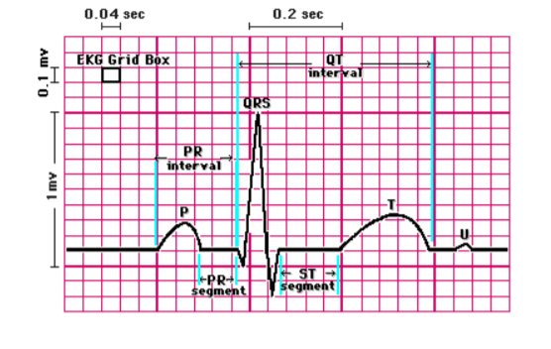
ABSTRACT:
The ECG records the electrical signal of the heart as the muscle cells depolarize (contract) and repolarize. The impulses of the heart are recorded as waves called P-QRS-T deflections.
A signal is passed through a digital bandpass filter Comparing this pulse amplitude with a suitable threshold, QRS peak is identified.

Slide 5
PURPOSE OF THE PROJECT:
We want to make a system wherein we can analyze a data of an ECG signal coming from a heart with the independence of the file format. Thus a user can analyze the heart signal on any simple PC having MATLAB. This will make it easier for figuring out the basic disabilities or diseases that can be detected from the heart beat pattern.

Slide 6
DISEASES & DISABLITIES DETECTED BY HEART RATE:
Heart rate could detect the low or high blood pressure which causes various heart problems such as-
High blood pressure causes chest pain, headaches, difficulty in breathing. Over time, if untreated, it can cause health conditions and lead to a fatal stroke.
Low blood pressure causes various problems such as dizziness or light-headedness, fainting, blurred vision, nausea, fatigue, lack of concentration.
Cholesterol could also be detected by irregular and high heart rates.

Slide 7
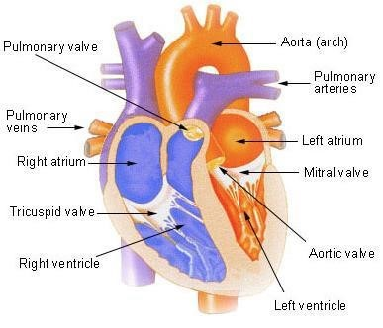
ANATOMICAL ASPECTS OF THE HEART:
The heart is basically a hollow muscular pump, which pushes the blood through out the body via the blood vessels. A normal sized healthy heart is roughly the same size as a fist and weighs around 250-300 g. It is located between the lungs and slightly to the left of center. The heart is an involuntary muscle that has approximately seventy to ninety contractions per minute during a restful state. It begins to pump early in the life of a fetus and will continue unceasingly until death.

Slide 8
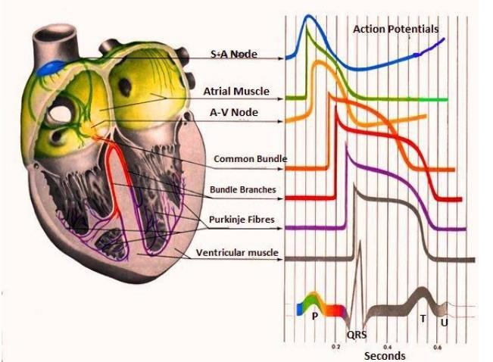
UNDERSTANDING ECG :
The Electrocardiogram (ECG) is a linear graph of the voltage fluctuations produced by the myocardium. The heart muscle possesses the property of automatic rhythmic contraction. This results in weak electric currents, which spread through the entire body. These can be recorded by placing electrodes at the various positions on the body and connecting them to an electrocardiographic apparatus.
Each cardiac cell is surrounded by and filled with solutions of Sodium (Na+), Potassium (K+), and Calcium (Ca++). The interior of the cell membrane is considered to be negative with respect to outside during resting conditions. When an electric impulse is generated in the heart, the interior part becomes positive with respect to the exterior. This change of polarity is called depolarization.. The ECG records the electrical signal of the heart as the muscle cells depolarize (contract) and repolarize.

Slide 9
IMPLEMENTATION:
-Start up MatLab.
-Type in the required code , save and then simulate.
-Plot the acquired data.
-Calculate the no. of peaks and measure heart rate.

Slide 10
CONCLUSION:
A new ECG signal simulation technique has been developed for the enhancement of the ECG identification algorithm design and testing. The preprocessing algorithm and time-frequency distribution, based on Wavelet Transform, was used to detect the QRS segment. The results reported have shown the capability of the algorithm to identify real ECG data. It is clear that the Wavelet Transform analysis method is leading to a new way of biomedical signal processing. This information can also serve as an input to a system that allows automatic cardiac diagnosis. The overall sensitivity of the detector improves. The main advantage of this kind of detection is less time consuming for long time ECG signal.

Slide 11
FUTURE SCOPE:
The project can be further developed in future by adding expert system features like speed variations with moving screen, exact heart rate with analysis, displaying 12 lead graphs.
We can enhance the feature of the project by enabling the transmission of ECG signals through mobiles, signal transmitters or internet.

Slide 12
REFRENCES:
https://en.wikipedia.org/wiki/Heart_rate
https://choosingwiselycanada.org/ecg-electrocardiogram/
https://www.betterhealth.vic.gov.au/health/conditionsandtreatments/ecg-test
https://www.mayoclinic.org/diseases-conditions/low-blood-pressure/symptoms-causes/syc-20355465
https://www.researchgate.net/post/what_are_the_diseases_that_can_be_detected_by_heart_rate_variability

